Slide 1
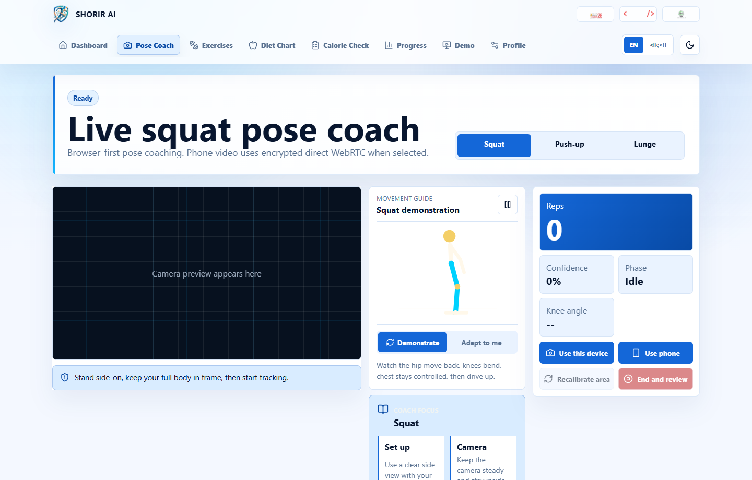
SHORIR AI
Movement Intelligence
A privacy-aware fitness assistant for strict pose coaching, Bangladeshi diet planning, calorie review, and progress tracking.
Mindsparks 26 CodeFront Challenge

Slide 2
SHORIR AI
Problem
Most fitness demos count movement, not correctness.
Product goal
Noisy camera landmarks can turn random movement into false reps.
Prefer strict, explainable guidance over easy but unreliable counting.
Generic meal plans ignore familiar local foods and serving patterns.
First-time users need a guided path, not a wall of controls.

Slide 3
SHORIR AI
Solution
One coordinated coaching loop
01
02
03
04
Profile
Coach
Nutrition
Progress
The refreshed UI keeps the next useful action visible while moving secondary detail into tabs and guided demo surfaces.

Slide 4
SHORIR AI
UI refresh
A calmer first viewport
The coach screen now has a compact intro, a dominant camera stage, a slim live readout rail, and hidden secondary tabs.

Slide 5
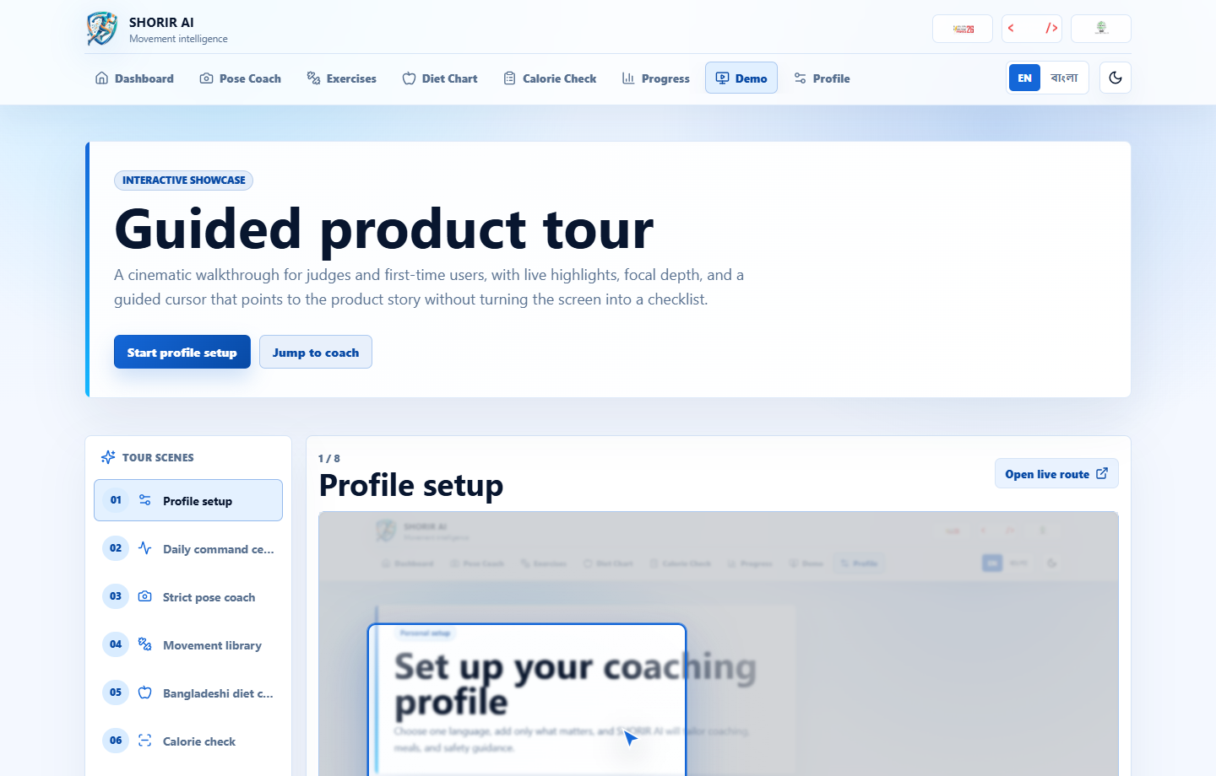
SHORIR AI
Demo sequence
Guide it like a product tour
Auto-play through real app frames with focal highlights.
Use cursor motion and captions to point out the story.
Pause on Pose Coach for the strict-rep explanation.
Open a live route only when judges want deeper inspection.

Slide 6
SHORIR AI
Pose quality
Strict reps over flattering reps
Confidence gate checks required landmarks before rep logic runs.
Acceptance
Temporal state machine requires top, controlled descent, confirmed depth, ascent, and stable lockout.
5 valid reps count as 5. Waving, partial crouches, and camera movement count as 0.
Bad distance, jitter, side switching, and incomplete depth pause the count.

Slide 7
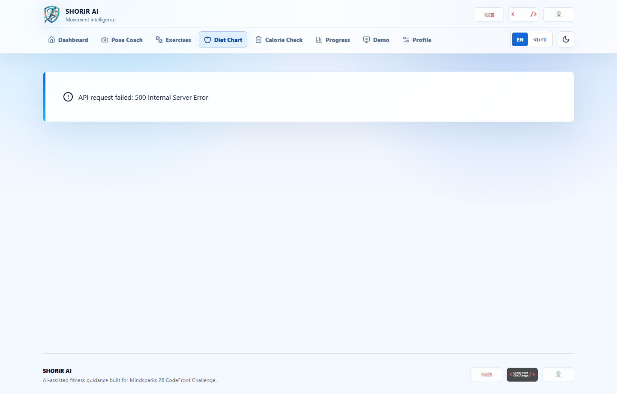
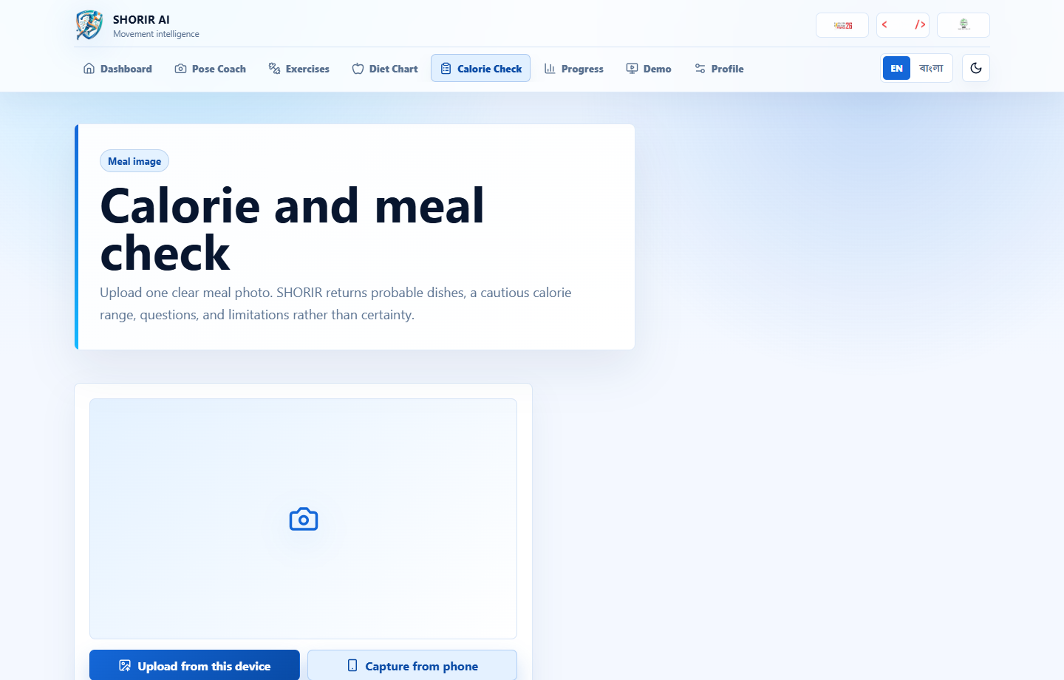
SHORIR AI
Nutrition
Food planning and calorie review
Local meal examples plus cautious AI food estimates keep the product useful beyond the workout camera.

Slide 8
SHORIR AI
Delivery
Submission package
Live website URL: shorir-ai-production.up.railway.app
READY
Demo route and MP4 walkthrough generated from live UI frames.
Project presentation and technical report regenerated from the same sequence.
Complete source ZIP packaged from the current committed workspace.

